Slide 1

Analysis of Covid-19 Data
Middleware Technologies for Distributed Systems 2020/2021

Slide 2
Problem
Starting from the dataset of new reported cases for each country daily we want to retrieve:
Seven days moving average of new reported cases, for each country andfor each day
Percentage increase (with respect to the day before) of the seven daysmoving average, for each country and for each day
Top 10 countries with the highest percentage increase of the seven daysmoving average, for each day

Slide 3

Technology
High level dataset description
Standard SQL queries execution
from a programming language
Optimize computation

Slide 4
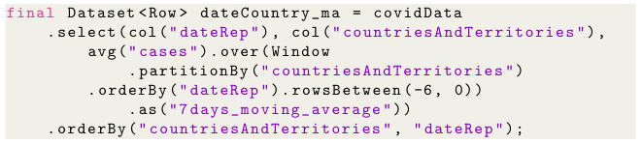
1 - Seven days moving average of new reported cases, for each country and for each day
Computes the average value of the previous seven entries

Slide 5
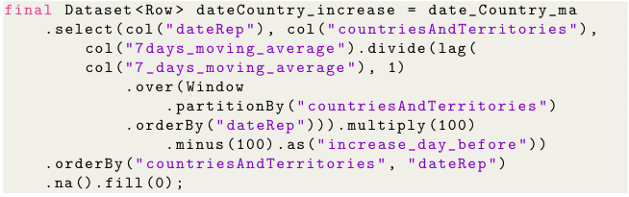
2 - Percentage increase (with respect to the day before) of the seven days moving average, for each country and for each day
Select each element and divide it by the previous one
Starting from the previous result...
Convert the result into percentage increase

Slide 6
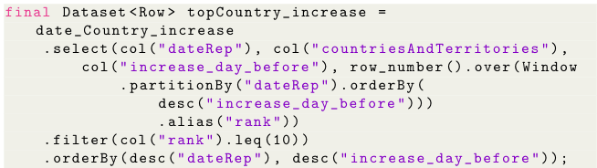
3 - Top 10 countries with the highest percentage increase of the seven days moving average, for each day
Starting from the previous result...
For each day, order countries by percentage increase (descending order)
Extract top 10, for each day

Slide 7

Testing - Hardware
CPU: Intel Core i5-8259U @ 2.30GHz
RAM: 8GB
CPU: Intel Core i5-8259U @ 2.30GHz
RAM: 8GB
CPU: Intel Core i7-8550U @ 1.80GHz
RAM: 8GB

Slide 8
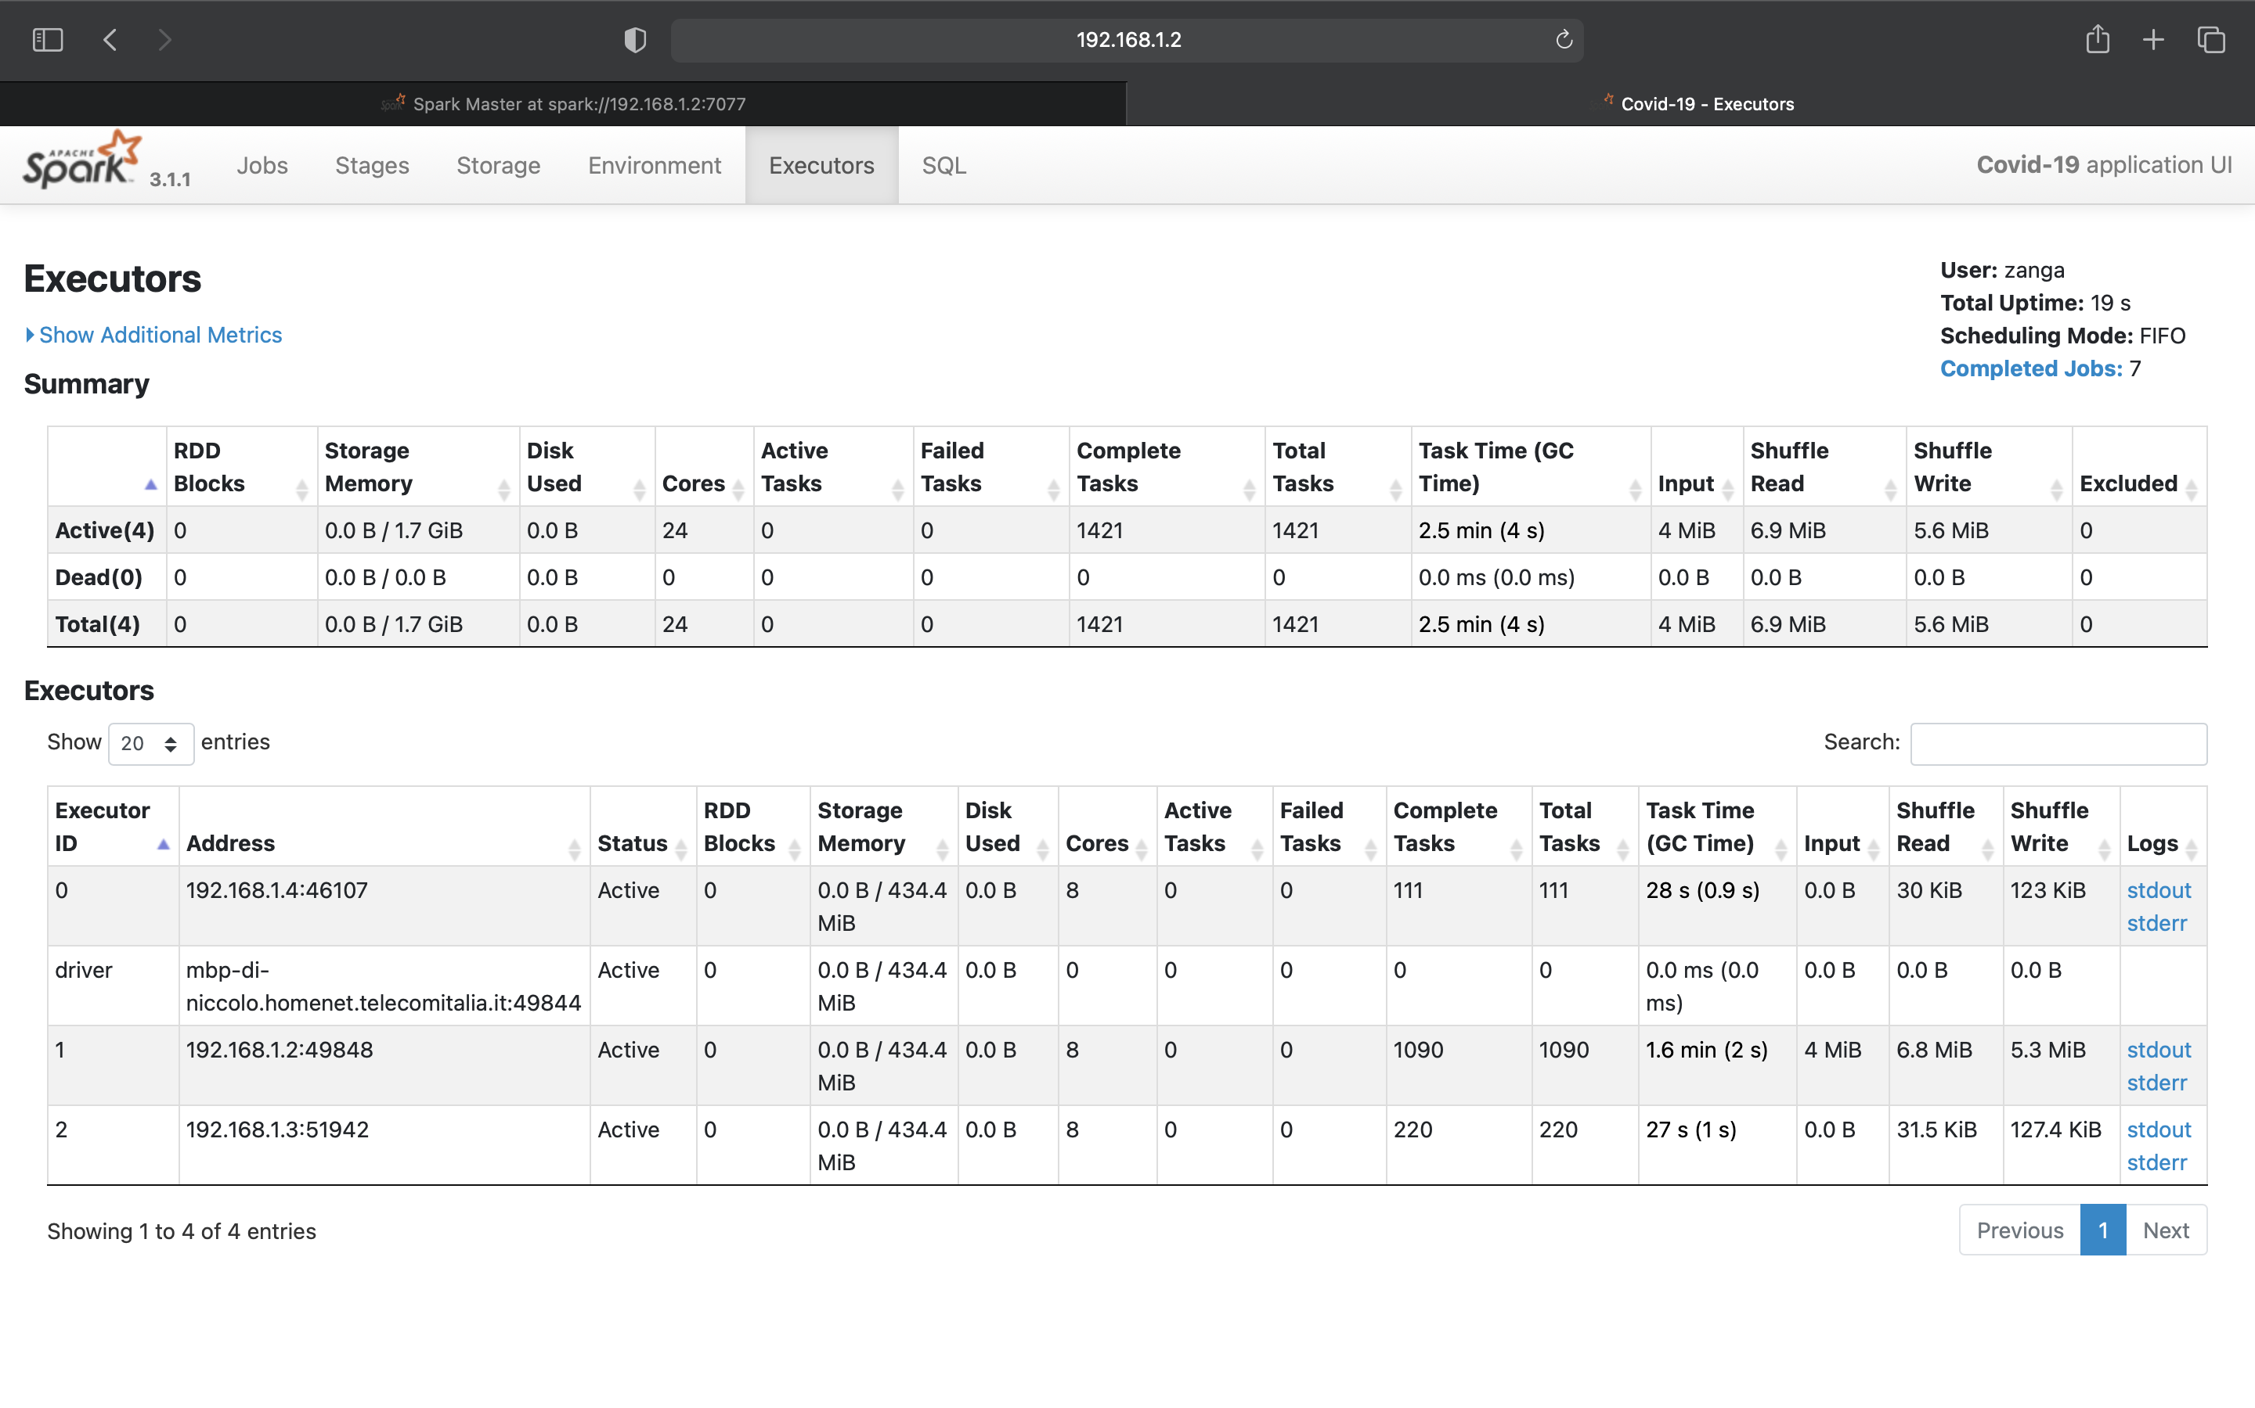
Test 1
Default parameters
Workload not evenly distributed

Slide 9

Test 2
3 sql partitions
All tasks executed by 1 Executor

Slide 10
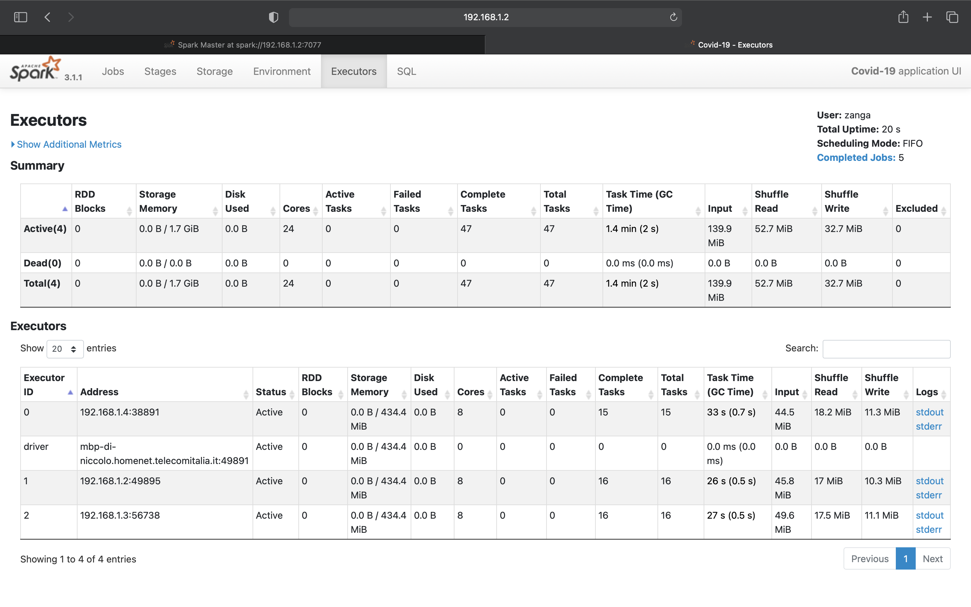
Test 3
Big dataset
3 sql partitions
Computation evenly distributed

Slide 11
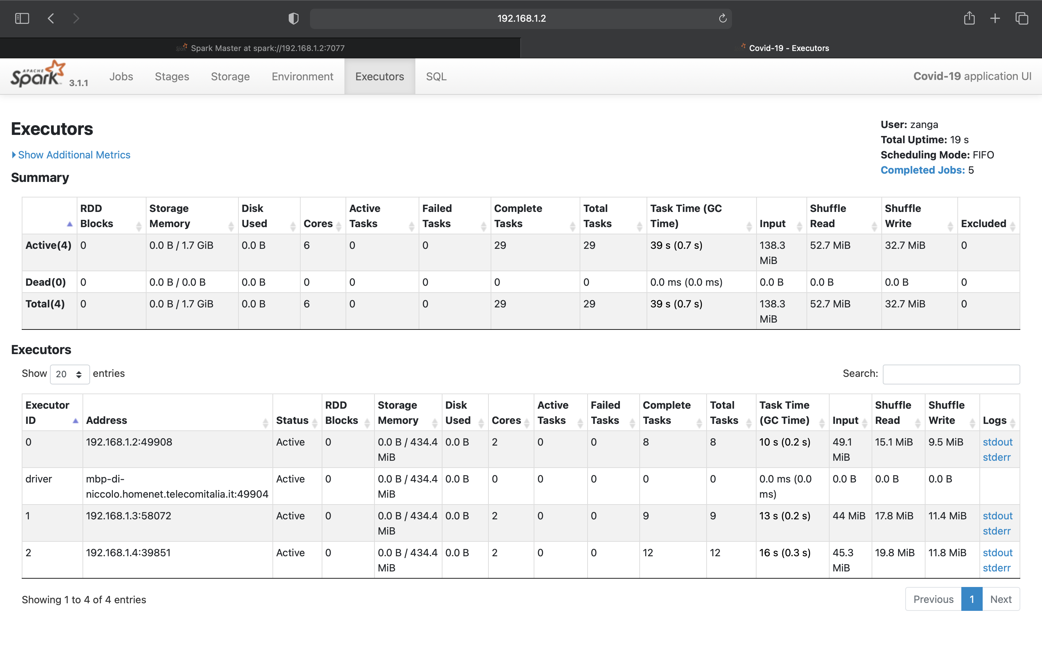
Test 4
2 cores per Executor
3 sql partitions
~ same computation time despite the lower computational power

Slide 12
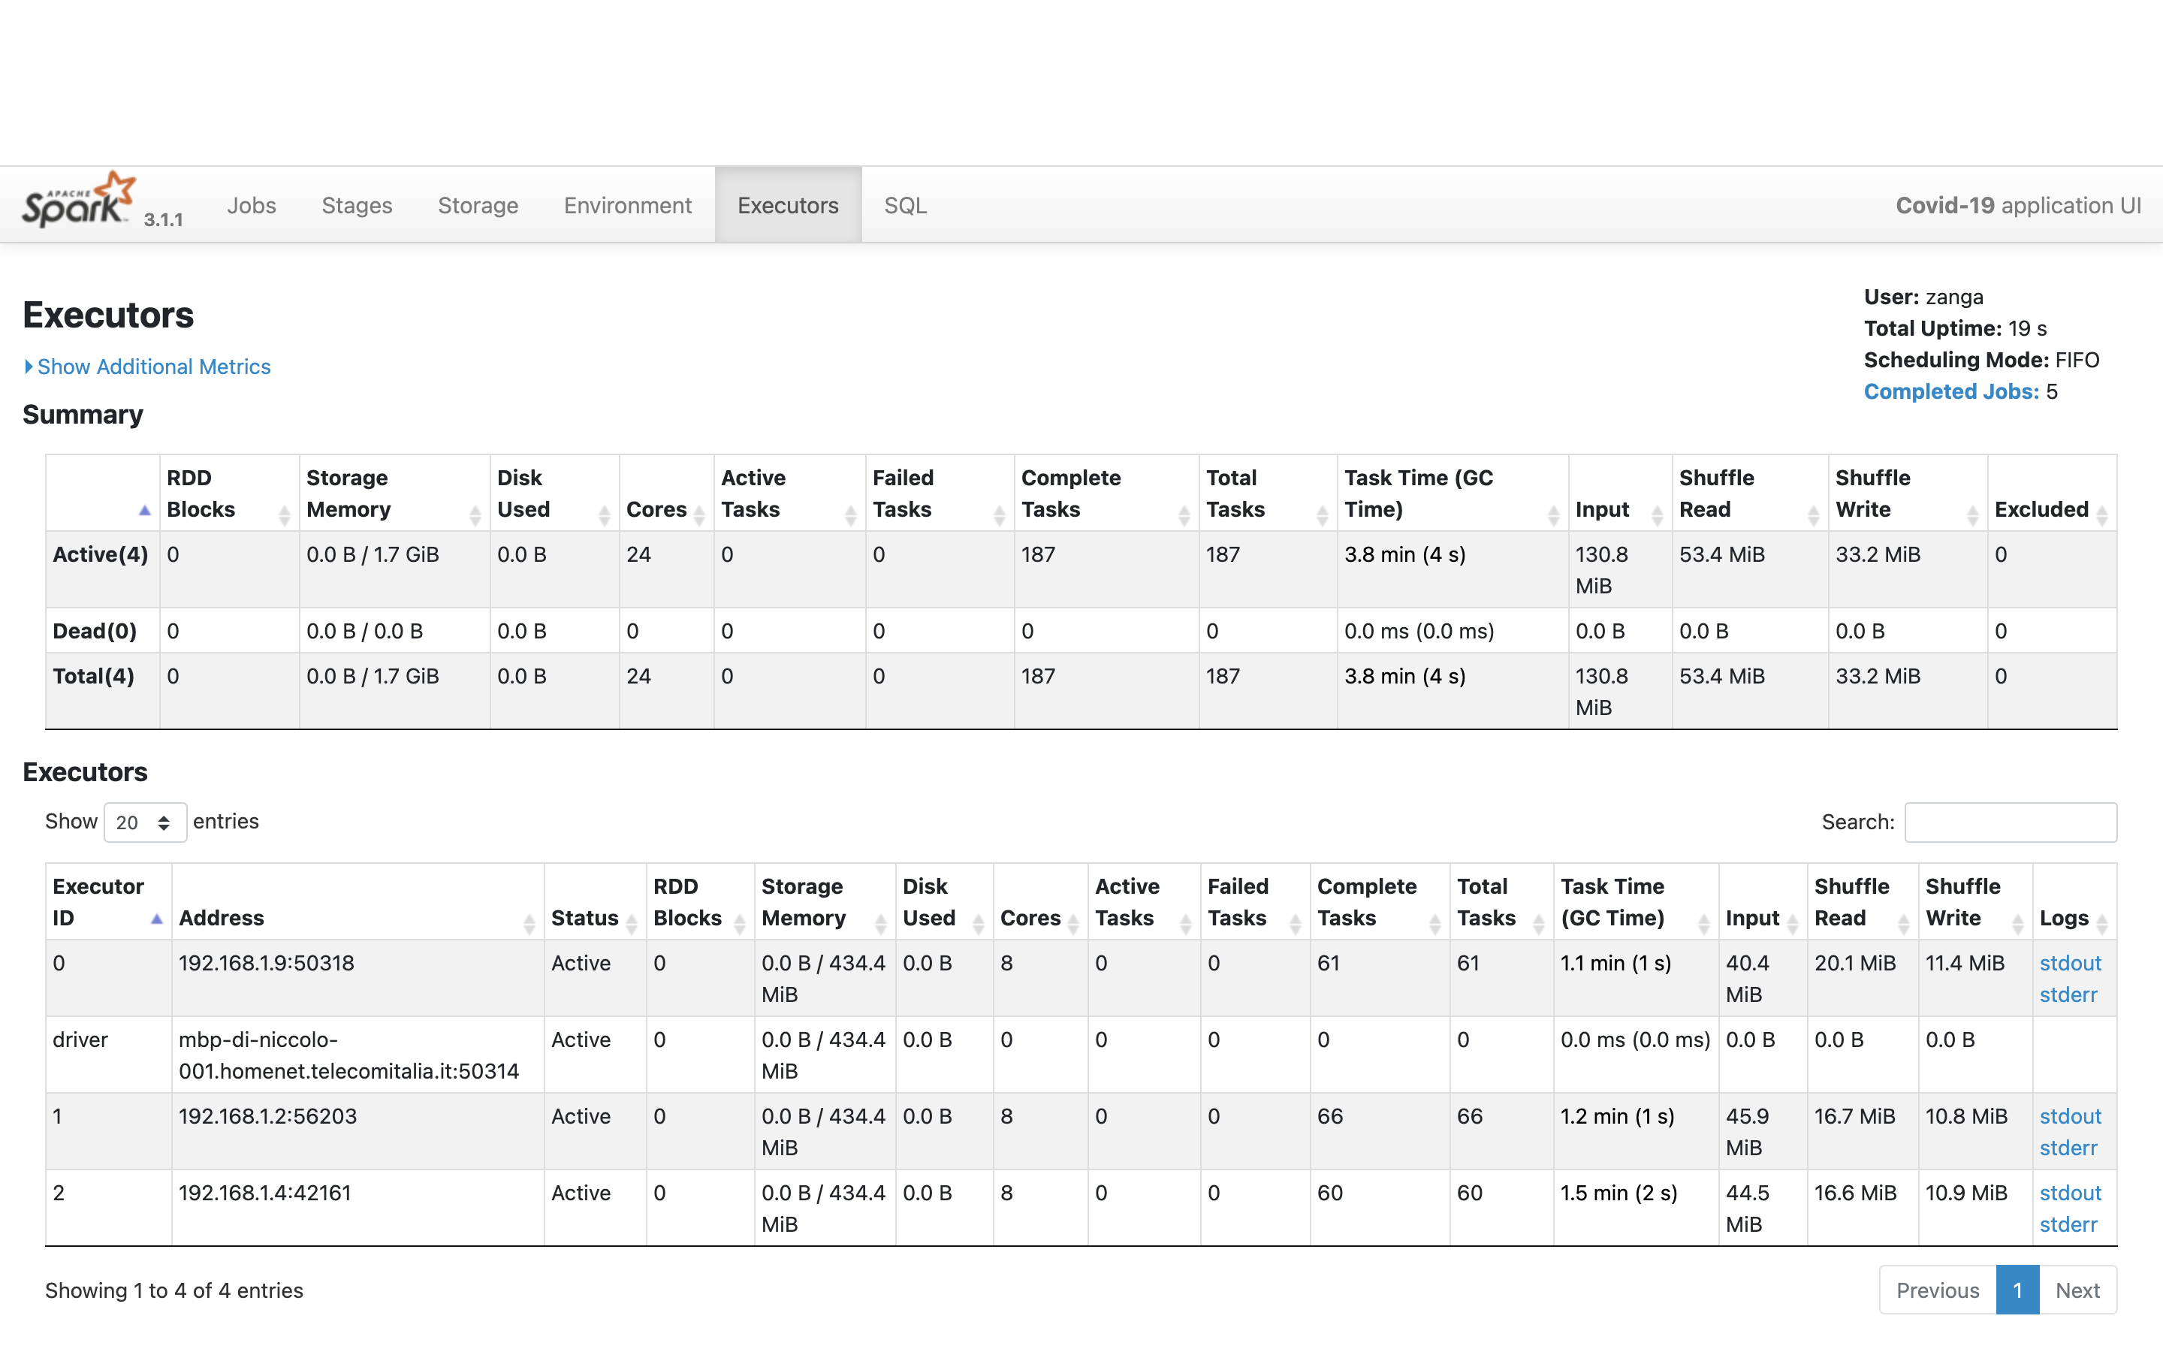
Test 5
24 sql partitions
8 cores per-Executor

